Slide 1
Database System (CS-406)
Lecture 06
Entity and its types
Ms. Rabia Gul
Lecturer, ITC

Slide 2
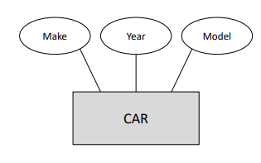
Entity Sets
An entity set is the set of entities the have the same attributes.
All cars have the year, make and the model.

Slide 3
Entity Sets
An entity set is a set of entities of the same type.
Attributes are associated with an entity set.
Attributes describe the properties of entities in the entity set.
Based on the values of certain attributes, an entity can be identified uniquely

Slide 4
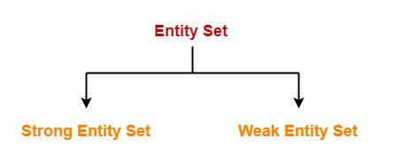
Types of Entity Sets

Slide 5
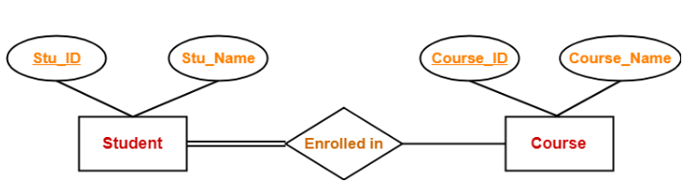
Strong Entity Set
A strong entity set is an entity set that contains sufficient attributes to uniquely identify all its entities.
In other words, a primary key exists for a strong entity set.
Primary key of a strong entity set is represented by underlining it.

Slide 6
Weak Entity Set
A weak entity set is an entity set that does not contain sufficient attributes to uniquely identify its entities.
In other words, a primary key does not exist for a weak entity set.
However, it contains a partial key called as a discriminator.
Discriminator can identify a group of entities from the entity set.
Discriminator is represented by underlining with a dashed line

Slide 7
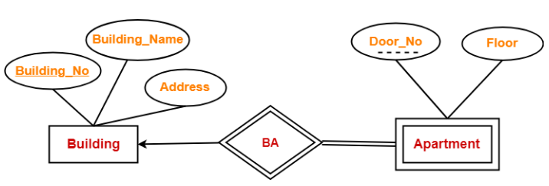
Weak Entity Set

Slide 8


